Slide 1
“ Personal Expenses Tracker ”
Presented by
Priyanshu Rathore Roll No. BCAN1CA23068
Gautam Yadav Roll No. BCAN1CA23031
Nikhil Kushwaha Roll No. BCAN1CA23053
Under the guidance of
Ms. Anjali Saraswat
Department of Computer Science Engineering
ITM University, Gwalior (M.P.)

Slide 2
Presentation Outline
Introduction
Objectives of the Project
Proposed System & Architecture
System Flowchart
Results & Screenshots
Testing & Validation
Conclusion & Future Work
References

Slide 3
Introduction
In today’s digital world, managing personal finances has become an essential task. Many individuals find it difficult to keep track of their daily income and expenses, which often leads to poor financial planning.
The Personal Finance Management System (Expense Tracker) is a web-based application designed to help users manage their finances effectively. It allows users to record income and expenses, calculate the total balance, and visualize financial data through charts.
The system is developed using HTML, CSS, and JavaScript, making it lightweight and easy to use without requiring any backend or database. Data is stored locally using the browser’s localStorage API.

Slide 4
Objectives of the Project
The main objectives of this project are: to develop a user-friendly system for tracking income and expenses, to provide real-time calculation of total balance, and to store transaction data securely using localStorage.
Additional objectives include: displaying a monthly financial summary using charts, helping users understand their spending habits through categorized transactions, and providing filter options to view income and expenses separately.

Slide 5
Proposed System & Modules
Input Module: Allows users to enter transaction details such as description, amount, and category (General, Food, Travel, Shopping, Salary).
Processing Module: Handles the logic for calculating total balance, income, and expenses in real time based on user-entered data.
Storage Module: Uses localStorage to store all transaction data in the browser, ensuring data persists even after refreshing the page.
Visualization Module: Displays financial data using Chart.js doughnut charts, providing a graphical monthly summary of income versus expenses.

Slide 6
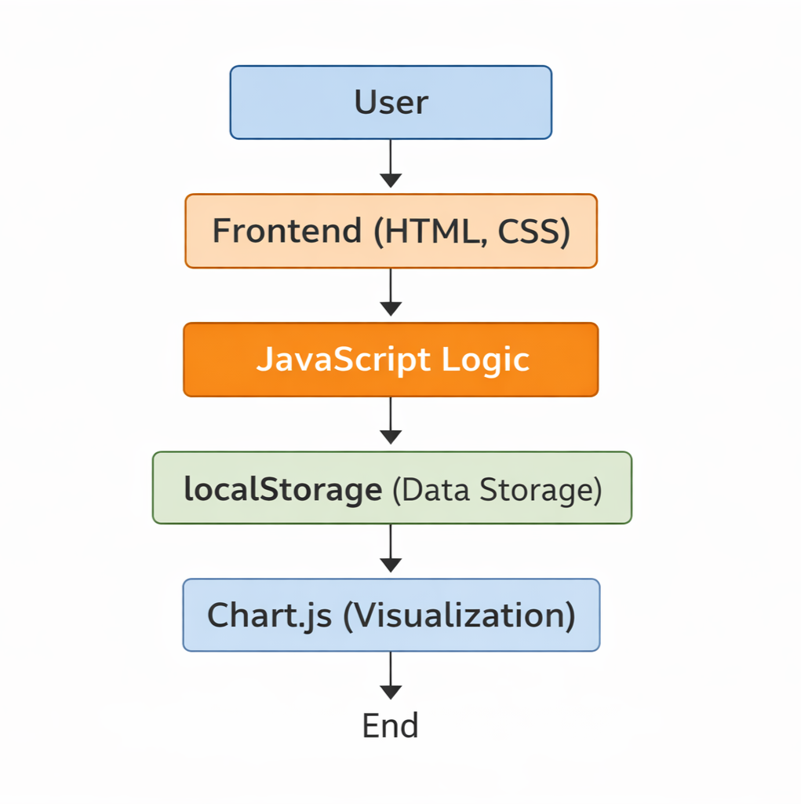
System Architecture
Client-Side Model: Simple browser-based architecture; no backend server required.
Frontend (HTML & CSS): Forms, transaction list, balance display, and filter controls.
JavaScript Logic: Adds/deletes transactions, calculates balance, updates interface dynamically.
localStorage + Chart.js: Persistent data storage in browser; doughnut chart for monthly summary.

Slide 7
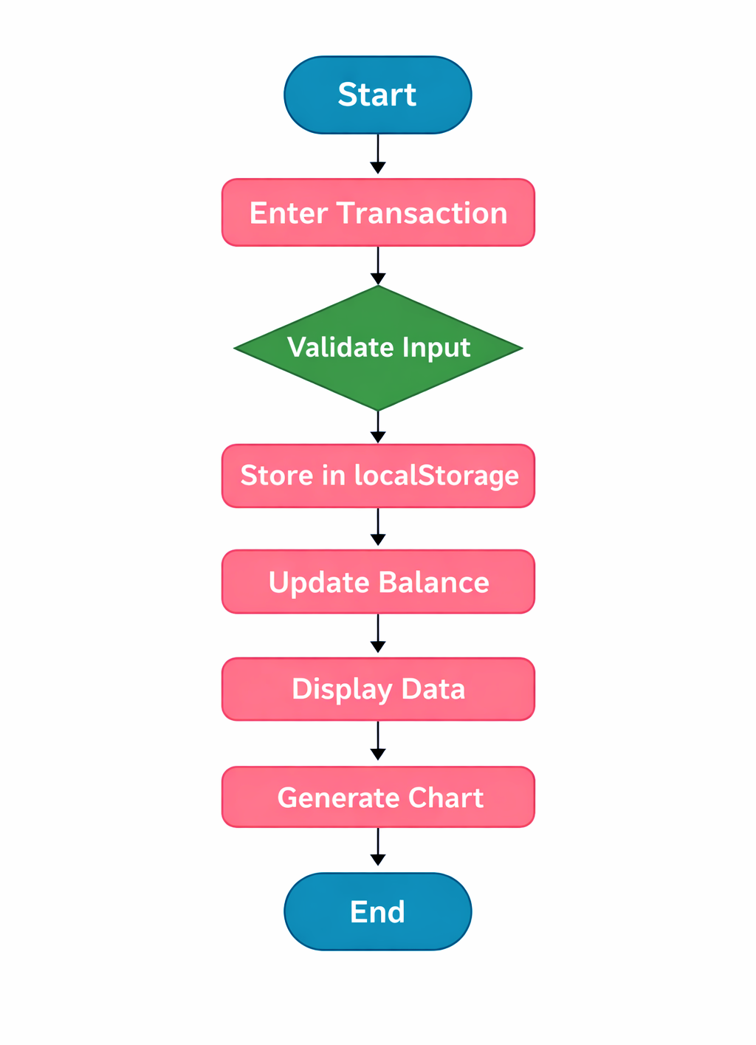
System Flowchart
Step 1: User enters transaction (description, amount, category)
Step 2: System validates input for correctness
Step 3: Transaction stored in localStorage
Step 4: Balance, income & expenses updated automatically
Step 5: Updated data displayed on screen
Step 6: Monthly chart generated via Chart.js

Slide 8
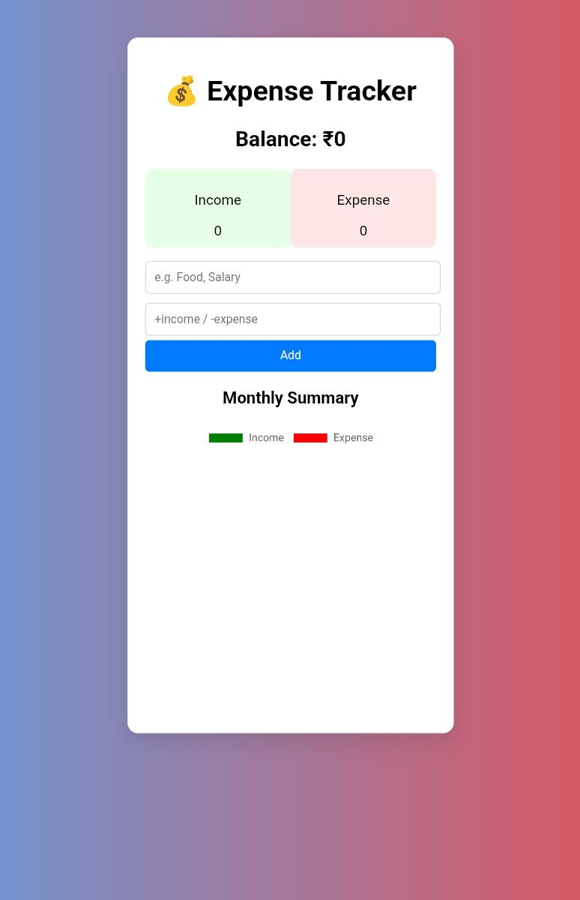
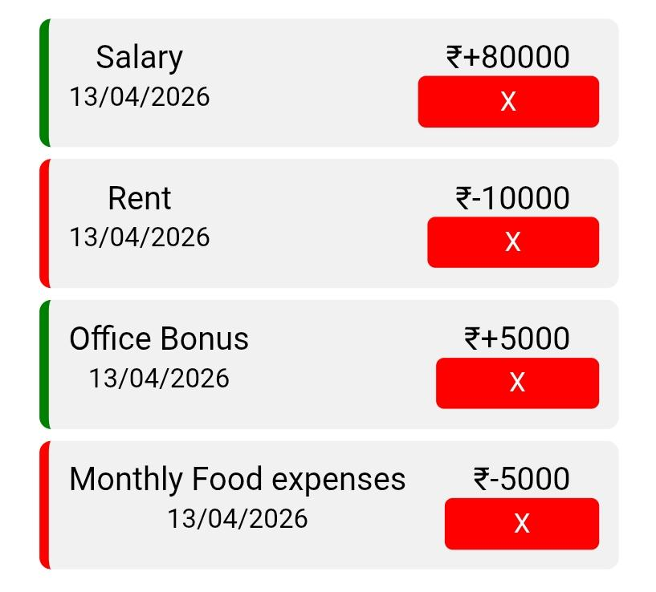
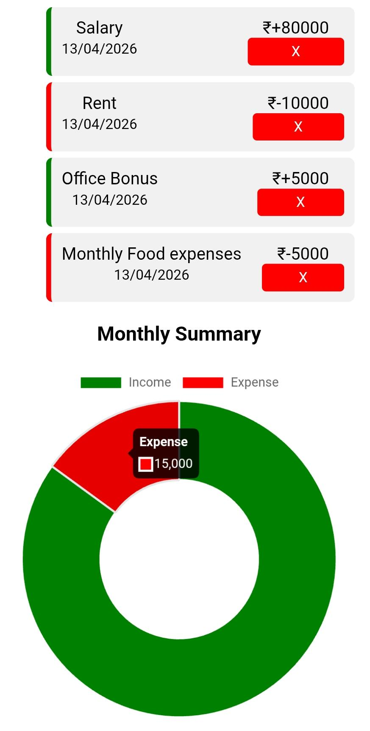
Results & Screenshots
The system successfully demonstrates real-time balance tracking, category-based transaction management, and visual monthly summaries.
Main Interface
Transaction List
Monthly Chart

Slide 9
Testing & Validation
Functional Testing: Verified add/delete transactions, filtering by income/expense, and category selection — all passed.
UI Testing: Interface verified for clarity, usability, and visual consistency across different input scenarios.
Data Validation Testing: Empty/invalid inputs trigger alerts; localStorage correctly persists data after page refresh.
System Limitations: No user authentication; data restricted to single device/browser; no advanced forecasting features.
All test cases passed — balance calculation, chart visualization, localStorage persistence, and filter system.

Slide 10
Conclusion & Future Work
Conclusion
The Personal Finance Management System was successfully designed and implemented to help users manage their daily financial activities. It allows users to add, delete, and categorize transactions while providing real-time balance updates.
The project demonstrates practical use of HTML, CSS, and JavaScript with features like filtering, chart visualization, and localStorage — achieving all its stated objectives.
Future Enhancements
User authentication with secure login credentials
Cloud-based storage for multi-device access
Budget planning, expense reminders & automated financial insights
Mobile app version for greater accessibility

Slide 11
References
Web Resources
[1] W3Schools, HTML Tutorial — https://www.w3schools.com/html/
[2] W3Schools, CSS Tutorial — https://www.w3schools.com/css/
[3] W3Schools, JavaScript Tutorial — https://www.w3schools.com/js/
[4] MDN Web Docs, JavaScript Guide — https://developer.mozilla.org/en-US/docs/Web/JavaScript
[5] Chart.js Documentation — https://www.chartjs.org/docs/
[6] MDN Web Docs, Web Storage API — https://developer.mozilla.org/en-US/docs/Web/API/Web_Storage_API
Books
[7] J. Duckett, “HTML and CSS: Design and Build Websites,” John Wiley & Sons, 2011.

